Slide 1

Khulna University of Engineering & Technology (KUET)
Institute of Information and Communication Technology (IICT)
Md. Ariful Islam Khandaker, IICT, KUET

Slide 2
Program and Language
What is a Computer Program?
A computer program is a set of instructions or statements (also called code) that is carried out by the computer’s CPU.
What is a Computer Language?
A language is a system of communication. A computer language is a means of communication used to communicate between people and the computer.
Md. Ariful Islam Khandaker, IICT, KUET

Slide 3

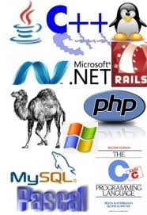
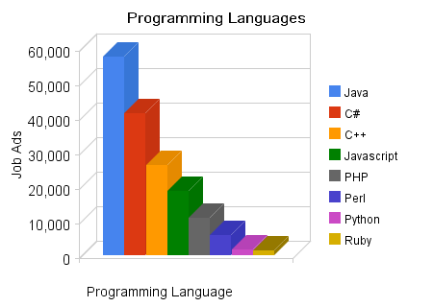
Md. Ariful Islam Khandaker, IICT, KUET

Slide 4
Different types of Programming Languages
  FORTRAN- Full name is FORmula TRANslation. Developed in 1957 for solving Scientific and Engineering Mathematical problems.
  COBOL- Full name is COmmon Business Oriented Language. Developed in 1960 for solving Business related problems.
  BASIC- Full name is Beginners All-purpose Symbolic Instruction Code. Developed in 1960 at Dart Mouth College of the United State for learning basic programming to the students.
  Pascal- Developed by the professor of Switzerland in 1970 for learning programming in easy way. It was the first modular programming language.
  C- C is developed for making programming simple and easy. A brief description is given to the next slide.
Md. Ariful Islam Khandaker, IICT, KUET

Slide 5
Overview of C
  ‘C’ was an offspring of the ‘Basic Combined Programming Language’ (BCPL) called ‘B’, developed by Martin Richards in the 1960’s at Cambridge University.
  ‘B’ language was modified by Dennis Ritchie and was implemented at Bell Laboratories in 1972. The new language was named C.
Importance of C
  It has rich set of built-in functions and operators.
  Programs written in C are efficient and fast.
  C is highly portable.
  Another important feature of C is its ability to extend itself.
  C is general purpose language. Unlike FORTRAN or COBOL, any kind of problem can be solved by C.
Md. Ariful Islam Khandaker, IICT, KUET

Slide 6
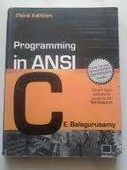
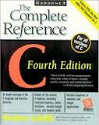
Website Link:
https://codeforwin.org/
PDF Link:
https://www.tutorialspoint.com/cprogramming/index.htm
Md. Ariful Islam Khandaker, IICT, KUET

Slide 7
What is Compiler?
  Computer is a fast electronic calculating machine. It works with two digits ‘0’ and ‘1’. It is called binary number system.
  ‘C’ is a symbolic language. So it needs to a translator which will translate C language to machine language or binary system.
  Compiler is a translator which translates High level language( Visual Basic) or Mid level language (C language) to machine level language( ‘0’ and ‘1’ language).
Compiler
Machine level
Language
(‘0’ and ‘1’)
High level
Language
C
Interpreter???
Md. Ariful Islam Khandaker, IICT, KUET

Slide 8
Executing A ‘C’ Program
Executing a program written in C involves a series of steps. These are:
    Creating the program.
    Compiling the program.
    Linking the program with functions that are needed from the C library.
    Executing the program.
What is Function?
Function is a technique of dividing program into small modules for doing
specific task.
Example of function:
return_type function name( )
{
function body
return_value
}
Md. Ariful Islam Khandaker, IICT, KUET

Slide 9
Simple C Program
# include <stdio.h>
int main( )
{
printf(“ This is a short C program.”);
return 0;
}
int: It means the program will return a integer value(0,1,2 etc). It is called function return type.
main( ) It is function name. Every C program must have main( ) function. The main( ) is where execution of program begin. Every program should have only one main( ) function.
{….} Brace Every function like main( ) function should have starting brace( ‘{‘ ) and closing brace ( ‘{‘ ).
printf(“…”) This is C’s general-purpose output library function. It displays the string which will be written within “ ”. That mean, it will display This is a short C program to output.
return 0 It means this function will return 0 to the system.
<stdio.h> It is called header file. “stdio” means Standard Input Output. This file is written within <..> and end with a .h extension. The C compiler uses the information in these files to handle the library functions like main( ), printf( ), properly. Add these files to program using the #include preprocessor directive.
End with semicolon(;) Except header file and main() function, every statement should end with semicolon(‘;’). And C programming is case sensitive.
Md. Ariful Islam Khandaker, IICT, KUET

Slide 10
Key Points to Remember
Every C program requires a main() function (Use of more than one main() is illegal. The place main is where the program execution begins.
The execution of a function begins at the opening brace of the function and ends at the corresponding closing brace.
C programs are written in lowercase letters.
All the words in a program line must be separated from each other by at least one space, or a tab, or a punctuation mark.
Every program statement in a C program must end with a semicolon.
A comment can be inserted almost anywhere.
We must make sure to include header files using #include directive when we use library functions. Remember there is no gap between # and include.
Md. Ariful Islam Khandaker, IICT, KUET

Slide 11

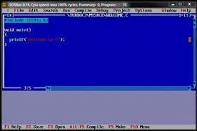
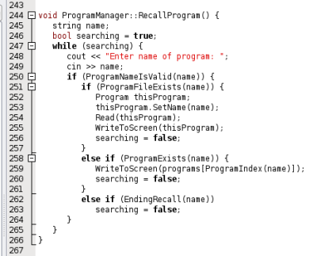
Turbo C++
Code Blocks
Notepad++
Dev-C++
https://www.codeblocks.org/downloads/
Md. Ariful Islam Khandaker, IICT, KUET

Slide 12
Thanks to all…
Md. Ariful Islam Khandaker, IICT, KUET

